Slide 1
Android Fundamental
Week 2

Slide 2
Introduction to Android
Android provides a rich application framework that allows you to build applications and games for mobile devices in Java language environment.
Multiple entry points
Android apps are built as a combination of distinct components that can be invoked individually.
Activities
Services
Content providers
Broadcast receivers
From one component you can start another component using an intent.
You can even start a component in a different app, such an activity in a maps to show an address.

Slide 3
Introduction to Android
This model provides multiple entry points for a single app and allows any app to behave as a user’s default for an action that other apps might invoke.
Apps adapt to different devices
Android provides an adaptive app framework that allows you to provide unique resources for different device configurations.
You can query the availability of device features at runtime if an app features require specific hardware such as a camera.
You can also declare your app requires to restrict incompatible devices for installation.

Slide 4
Application Fundamental
Android apps are written in Java.
Android SDK tools compile your code- along with any data and resource files into APK: an Android package, .apk
Once installed on device, each Android app lives in its own sandbox.
Android operating system is a multi-user Linux system in which each app is a different user.
By default, the systems assigns each app a unique Linux user ID. The system sets permissions for all the files in an app so that only the user ID assigned to the app can access them.
Each process has its own virtual machine(VM), so an app’s code runs in isolation from other apps.
By default, each app runs its own Linux process. Android starts the process when any of the app's components need to be executed, then shuts down the process when it's no longer needed or when the system must recover memory for other apps.

Slide 5
Application Fundamental
Android system implements the principle of least privilege. By default, has access only to the components that it requires to do its work and no more. This creates a very secure environment in which an app cannot access parts of the system for which it is not given permission.
For sharing data between two apps:
Two apps can share the same Linux user ID, in which case they are able to access each other's files.
An app can request permission to access device data such as the user's contacts, SMS messages…..etc.

Slide 6
App Components
App components are the essential building blocks of an Android app. Each component is a different point through which the system can enter your app.
There are FOUR different types of app components. Each type serves a distinct purpose and has a distinct lifecycle that defines how the component is created and destroyed.
Activities
An activity represents a single screen with a user interface.
Although the activities work together to form a cohesive user experience, each one is independent of the others.
Different app can start any one of these activities. (Camera in email app)
An activity is implemented as a subclass of Activity.

Slide 7
App Components
Services
A service is a component that runs in the background to perform long-running operations or to perform work for remote processes.
A service does not provide a user interface. (eg:-Background music)
Another component, such as an activity, can start the service and let it run or bind to it in order to interact with it.
A service is implemented as a subclass of Service.

Slide 8
App Components
Content Providers
A content provider manages a shared set of app data.
Data could be in the file system, an SQLite database, on the web, or any other persistent storage location your app can access.
Through the content provider, other apps can query or even modify the data (if the content provider allows it).
Any app with the proper permissions can query part of the content provider (such as ContactsContract.Data) to read and write information about a particular person.
Content providers are also useful for reading and writing data that is private to your app and not shared.
A content provider is implemented as a subclass of ContentProvider and must implement a standard set of APIs that enable other apps to perform transactions.

Slide 9
App Components
Broadcast Receivers
A broadcast receiver is a component that responds to system-wide broadcast announcements.
Many broadcasts originate from the system—for example, a broadcast announcing that the screen has turned off, the battery is low, or a picture was captured.
Apps can also initiate broadcasts—for example, to let other apps know that some data has been downloaded to the device and is available for them to use.
May create a status bar notification to alert the user when a broadcast event occurs.
A broadcast receiver is implemented as a subclass of BroadcastReceiver and each broadcast is delivered as an Intent object.

Slide 10
App Components-working
A unique aspect of the Android system design is that any app can start another app’s component. Eg:- start the camera app.
When the system starts a component, it starts the process for that app (if it's not already running) and instantiates the classes needed for the component.
System runs each app in a separate process with file permissions that restrict access to other apps, your app cannot directly activate a component from another app.
To activate a component in another app, you must deliver a message to the system that specifies your intent to start a particular component.

Slide 11
Activating Components
Three of the four component types—activities, services, and broadcast receivers—are activated by an asynchronous message called an intent.
Intents bind individual components to each other at runtime.
An intent is created with an Intent object, which defines a message to activate either a specific component or a specific type of component—an intent can be either explicit or implicit.
For activities and services, an intent defines the action to perform and may specify the URI of the data to act on.
For broadcast receivers, the intent simply defines the announcement being broadcast.
Content provider, is not activated by intents. But activated when targeted by a request from a ContentResolver.

Slide 12
Activating Components
There are separate methods for activating each type of component:
You can start an activity by passing an Intent to startActivity() or startActivityForResult().
You can start a by passing an Intent to startService(). Or you can bind to the service by passing an Intent to bindService().
You can initiate a broadcast by passing an Intent to methods like sendBroadcast(),sendOrderedBroadcast(), or sendStickyBroadcast().
You can perform a query to a content provider by calling query() on a ContentResolver.

Slide 13
Manifest File
Android system understand the components by reading the app's AndroidManifest.xml file (the "manifest" file). Your app must declare all its components in this file, which must be at the root of the app project directory.
Manifest also performs:
Identify any user permissions the app requires, such as Internet access or read-access to the user's contacts.
Declare the minimum API Level required by the app, based on which APIs the app uses.
Declare hardware and software features used or required by the app, such as a camera, bluetooth services, or a multitouch screen.
API libraries the app needs to be linked against (other than the Android framework APIs), such as the Google Maps library.

Slide 14
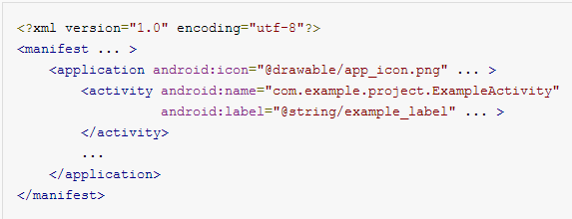
Manifest-declaring components
The primary task of the manifest is to inform the system about the app's components.
In the <application> element, the android:icon attribute points to resources for an icon that identifies the app.
In the <activity> element, the android:name attribute specifies the fully qualified class name of the Activity subclass and the android:label attributes specifies a string to use as the user-visible label for the activity.

Slide 15
Manifest-declaring components
All app components declared this way:
<activity> elements for activities
<service> elements for services
<receiver> elements for broadcast receivers
<provider> elements for content providers
Activities, services, and content providers that you include in your source but do not declare in the manifest are not visible to the system and, consequently, can never run.
Broadcast receivers can be either declared in the manifest or created dynamically in code (as BroadcastReceiver objects) and registered with the system by calling registerReceiver().

Slide 16
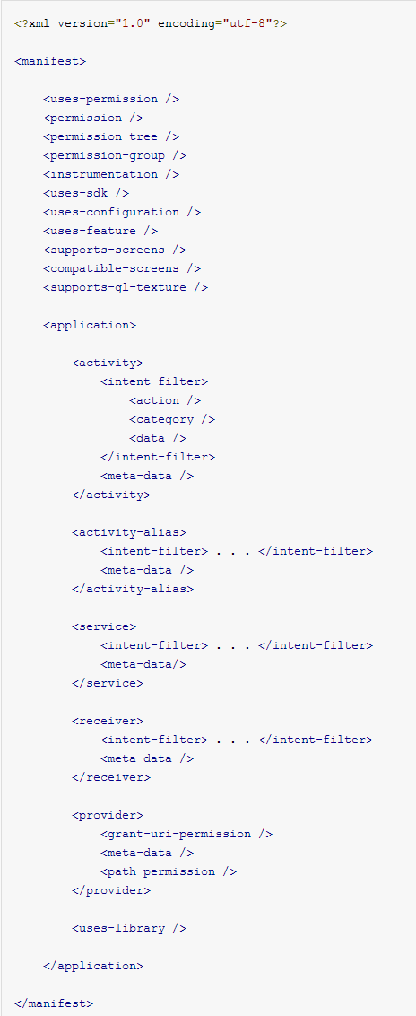
Structure of Manifest

Slide 17
Structure of Manifest
These are the only legal elements; you cannot add your own elements or attributes.
<action> <activity> <activity-alias> <application> <category> <data> <grant-uri-permission> <instrumentation> <intent-filter> <manifest> <meta-data>
<permission> <permission-group> <permission-tree> <provider > <receiver> <service> <supports-screens> <uses-configuration> <uses-feature> <uses-library> <uses-permission> <uses-sdk>

Slide 18
Configuring the Android Manifest
AndroidManifest.xml information is used by the Android system to
Install and upgrade the application package
Display the application’s name, description, and icon to users
Specify application system requirements
Supported Android SDKs
Device configurations required (e.g., D-pad navigation)
Platform features relied upon (e.g., multitouch)
Specify features required by the application for market filtering
Register application activities and when they should be launched
Manage application permissions
Configure and define services, broadcast receivers, and content providers
Specify intent filters for activities, services, and broadcast receivers
Enable application settings and configurations

Slide 19
Editing the Android Manifest File Using the Android IDE
Use the Android IDE manifest file resource editor or manually edit the XML
The Android IDE manifest file resource editor organizes the manifest info into categories:
Manifest tab
Application tab
Permissions tab
Instrumentation tab
AndroidManifest.xml tab

Slide 20
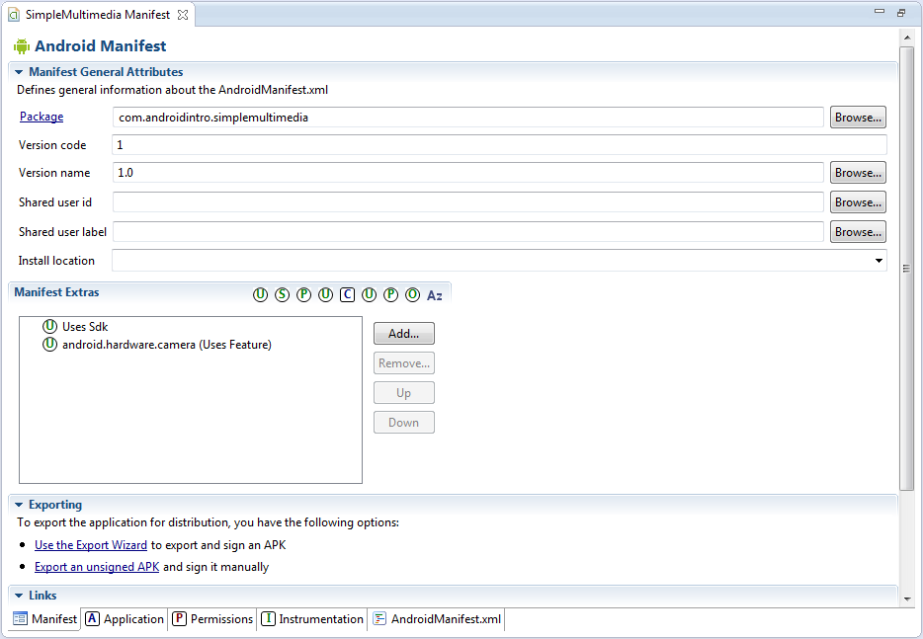
Configuring Package-Wide Settings Using the Manifest Tab
SimpleMultimedia application AndroidManifest.xml
Notes:
The Manifest tab contains package-wide settings, including the package name, version information, and supported Android SDK information.
You can also set any hardware or feature requirements here.

Slide 21
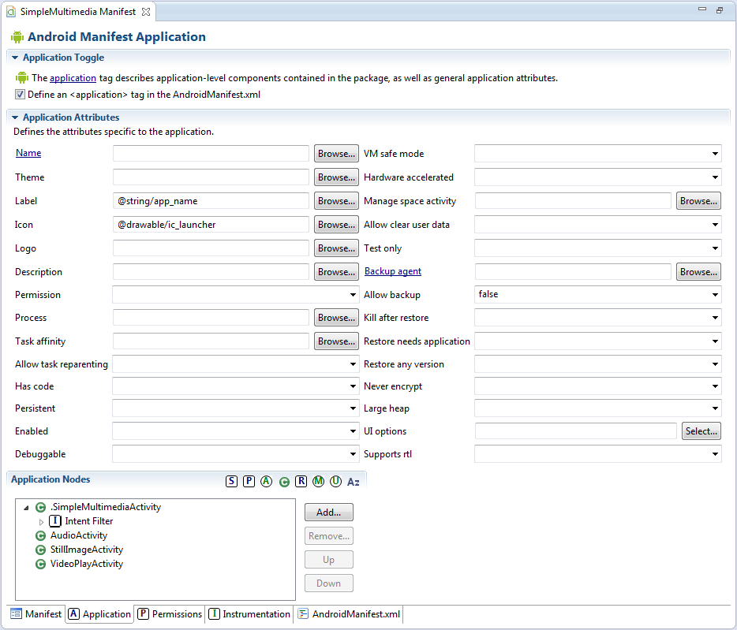
Managing Application and Activity Settings
Notes:
The Application tab contains application-wide settings, including the application label and icon, as well as information about the application components, such as activities, and other application components, including configuration for services, intent filters, and content providers.

Slide 22
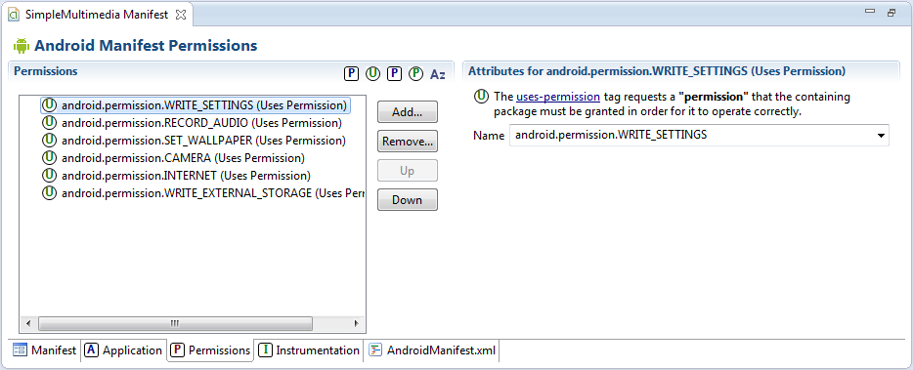
Enforcing Application Permissions
Notes:
The Permissions tab contains any permission rules required by your application.
This tab can also be used to enforce custom permissions created for the application.

Slide 23
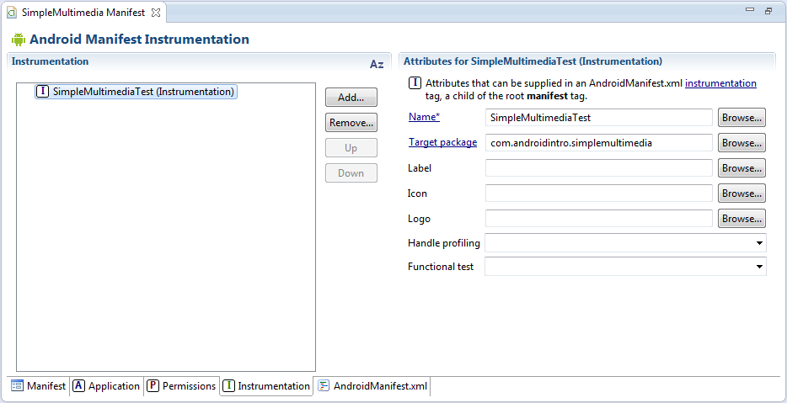
Managing Test Instrumentation
Notes:
The Instrumentation tab allows the developer to declare any instrumentation classes for monitoring the application.

Slide 24
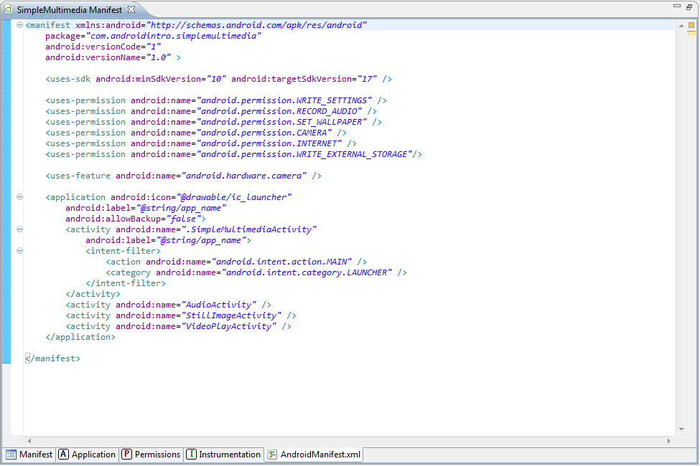
Editing the Manifest File Manually
Notes:
The Android manifest file is a specially formatted XML file.
You can edit the XML manually by clicking the AndroidManifest.xml tab.
Android manifest files generally include a single <manifest> tag with a single <application> tag.
The image is a sample AndroidManifest.xml file.

Slide 25
Editing the Manifest File Manually
A summary of what this file tells us about the SimpleMultimedia application
The package name is com.introtoandroid.simplemultimedia
The version name is 1.0
The version code is 1
The application name is stored in the resource string @string/app_name within the /res/values/strings.xml resource file
The application icon is the file called ic_launcher found in the /res/drawable-* directory
There are four activities
SimpleMultimediaActivity is the primary entry point
Requires the following permissions: write settings, record audio, set wallpaper, access the camera, Internet, and write to external storage
The application works from any API level from 10 to 18
A camera is required to work properly

Slide 26
Managing Your Application’s Identity
<manifest xmlns:android="http://schemas.android.com/apk/res/android"
package="com.androidintro.simplemultimedia"
android:versionCode="1"
android:versionName="1.0">
Notes:
Your application’s Android manifest file defines the application properties.
The package name must be defined in the Android manifest file within the <manifest> tag using the package attribute.

Slide 27
Versioning Your Application
Versioning your application is vital to maintaining it in the field
Intelligent versioning can help reduce confusion and make product support and upgrades simpler
Two different version attributes are defined within the <manifest> tag
The version name
The version code

Slide 28
Versioning Your Application
The version name (android:versionName) is a user-friendly, developer-defined version attribute
This information is displayed to users when they manage applications on their devices and when they download the application from marketplaces
Developers use this version information to keep track of their application versions in the field
Android uses the version code (android:versionCode), a numeric attribute, to manage application upgrades

Slide 29
Setting the Application Name and Icon
Overall application settings are configured with the <application> tag of the Android manifest file
Here you set information such as the application icon (android:icon) and friendly name (android:label)
These settings are attributes of the <application> tag
You can also set optional application settings as attributes in the <application> tag
android:description
android:debuggable="true"

Slide 30
Setting the Application Name and Icon
<application android:icon="@drawable/ic_launcher"
android:label="@string/app_name"
androidDebuggable="true" >

Slide 31
Enforcing Application System Requirements
System requirements can be defined and enforced in the Android manifest file
When an application is installed on a device, the Android platform checks these requirements and will error out if necessary
The Google Play store uses information in the Android manifest file to filter which applications to offer to which devices so that users install applications that work on their devices

Slide 32
Enforcing Application System Requirements
Developers can configure some application system requirements in the manifest:
Android SDK versions supported
Platform features used
Hardware configurations required
Screen sizes and pixel densities supported
External libraries

Slide 33
Targeting Specific SDK Versions
Developers can specify which versions of the Android platform an application supports
Defined with the <uses-sdk> tag
This tag has three important attributes:
minSdkVersion
targetSdkVersion
maxSdkVersion
Notes:
minSdkVersion attribute
This attribute specifies the lowest API level that the application supports.
targetSdkVersion attribute
This attribute specifies the optimum API level that the application supports.
maxSdkVersion attribute
This attribute specifies the highest API level that the application supports.

Slide 34
Targeting Specific SDK Versions
Each attribute of the <uses-sdk> tag is an integer
Represents the API level associated with a given Android SDK
The value does not directly correspond to the SDK version
It is the revision of the API level associated with that SDK
The API level is set by the developers of the Android SDK
You need to check the SDK documentation to determine the API level value for each version

Slide 35
Android SDK Versions and Their API Levels
Android SDK Version | API Level | Code Name/Version Code
Android 1.0 | 1 | BASE
Android 1.1 | 2 | BASE_1_1
Android 1.5 | 3 | CUPCAKE
Android 1.6 | 4 | DONUT
Android 2.0 | 5 | ECLAIR
Android 2.0.1 | 6 | ECLAIR_0_1
Android 2.1.X | 7 | ECLAIR_MR1
Android 2.2.X | 8 | FROYO
Android 2.3, 2.3.1, 2.3.2 | 9 | GINGERBREAD
Android 2.3.3, 2.3.4 | 10 | GINGERBREAD_MR1
Android 3.0.X | 11 | HONEYCOMB
Android 3.1.X | 12 | HONEYCOMB_MR1
Android 3.2 | 13 | HONEYCOMB_MR2
Android 4.0, 4.0.1, 4.0.2 | 14 | ICE_CREAM_SANDWICH
Android 4.0.3, 4.0.4 | 15 | ICE_CREAM_SANDWICH_MR1
Android 4.1, 4.1.1 | 16 | JELLY_BEAN
Android 4.2, 4.2, 4.2.2 | 17 | JELLY_BEAN_MR1
Android 4.3 | 18 | JELLY_BEAN_MR2

Slide 36
Specifying the Minimum SDK Version
You should always specify the minSdkVersion attribute for your application
This represents the lowest SDK you support

Slide 37
Specifying the Minimum SDK Version
<uses-sdk android:minSdkVersion="4" />
Notes:
For example, if your application requires APIs introduced in Android SDK 1.6, you would check that SDK’s documentation and find that this release is defined as API Level 4.
Therefore, add the following to your Android manifest file within the <manifest> tag block.

Slide 38
Specifying the Minimum SDK Version
It’s that simple!
Use the lowest API level possible if you want your application to be compatible with the largest number of Android devices
You must ensure that your application is tested sufficiently on any non-target platforms
Meaning: any API level supported below your target SDK

Slide 39
Specifying the Target SDK Version
You should always specify the targetSdkVersion attribute
This value represents the Android SDK version your application was built for and tested against

Slide 40
Specifying the Target SDK Version
<uses-sdk android:minSdkVersion="10" android:targetSdkVersion="18" />
Notes:
For example, if your application was built using APIs that are backward compatible to Android 2.3.3 (API Level 10) but targeted and tested using Android 4.3 SDK (API Level 18), you would want to specify the targetSdkVersion attribute as 18.
Therefore, add this line to your Android manifest file within the <manifest> tag block.

Slide 41
Specifying the Target SDK Version
Why should you specify the target SDK version you used?
Android has built-in functionality for backward compatibility
Only to a point though
Think of it like this
A specific API method might have been around since API Level 1
However, the internals of that method—its behavior—might have changed slightly from SDK to SDK
By specifying the target SDK version for your application
Android tries matching your app with the exact version of the SDK
And the behavior as you tested it
Even when running a different (newer) version of the platform
What does this mean?
The application should continue to behave in “the old way” despite any changes or “improvements” to the SDK that might cause unintended consequences in your application

Slide 42
Specifying the Maximum SDK Version
You will rarely want to specify the maxSdkVersion attribute
This value represents the highest Android SDK version your application supports
In terms of API level
It restricts forward compatibility of your application
One reason you might want to set this attribute is if you want to limit who can install the application to exclude devices with the newest SDKs
For example . . .
In short
Use maxSdkVersion only when absolutely necessary and when you understand the risks associated with its use
Notes:
For example . . .
You might develop a free beta version of your application with plans for a paid version for the newest SDK.
By setting the maxSdkVersion attribute of the manifest file for your free application, you disallow anyone with the newest SDK to install the free version.
The downside of this idea?
If your users have devices that receive over-the-air SDK updates, your application would cease to work (and appear) on devices where it had previously functioned perfectly, which might upset your users and result in bad ratings on your market of choice.

Slide 43
Enforcing Application Platform Requirements
Android devices have different hardware and software configurations
Some have built-in keyboards
Others rely on the software keyboard
Some support the latest 3D graphics libraries
Others provide little or no graphics support
The Android manifest file has several informational tags for flagging the system features and hardware configurations supported or required by an Android application

Slide 44
Specifying Supported Input Methods
<uses-configuration>
For specifying hardware and software input methods
There are different configuration attributes for five-way navigation
Hardware keyboard and keyboard types
Directional pad
Trackball
Wheel
Touchscreen settings
There is no “OR” support!
To support many input configurations
Define multiple <uses-configuration> tags

Slide 45
Specifying Supported Input Methods
<uses-configuration
android:reqHardKeyboard="true"
android:reqTouchScreen="finger" />
<uses-configuration
android:reqHardKeyboard="true"
android:reqTouchScreen="stylus" />
Notes:
For example, if your application requires a physical keyboard and touchscreen input using a finger or a stylus, you need to define two separate <uses-configuration> tags in your manifest file.

Slide 46
Specifying Required Device Features
The <uses-feature> tag is used to specify features your application uses to run properly
These settings are for informational purposes only
Android does not enforce these settings
Publication channels such as Google Play use this information to filter the applications available to a given user
Other applications might check this information as well

Slide 47
Specifying Required Device Features
<uses-feature android:name="android.hardware.sensor.light" />
<uses-feature android:name="android.hardware.sensor.proximity" />
Notes:
For example, an application that requires both a light and a proximity sensor requires two tags.

Slide 48
Specifying Required Device Features
One common reason to use the <uses-feature> tag is to specify the OpenGL ES versions supported
All applications function with OpenGL ES 1.0 by default
However, if your app requires features available in later versions of OpenGL ES (such as 2.0), you must specify this feature
Do this with the android:glEsVersion attribute of <uses-feature>
Specify the lowest version of OpenGL ES that the application requires

Slide 49
Specifying Supported Screen Sizes
Android devices come in many shapes and sizes
Screen sizes and pixel densities vary
The <supports-screens> tag can be used to specify the types of screens supported
Android categorizes screen types in terms of
Sizes
small, normal, large, and xlarge
Pixel density
LDPI, MDPI, HDPI, and XHDPI
Or rather low-, medium-, high-, and extra-high-density displays

Slide 50
Specifying Supported Screen Size
<supports-screens
android:smallScreens="true"
android:normalScreens="true"
android:largeScreens"false"
android:anyDensity="true"/>
Notes:
For example, if the application supports QVGA screens (small) and HVGA, WQVGA, and WVGA screens (normal) regardless of pixel density, the application’s <supports-screens> tag is configured.

Slide 51
Working with External Libraries
You can register shared libraries your application links to within the Android manifest file
Every application is linked to the standard Android packages (such as android.app) and is aware of its own package
However, if your application links to additional packages, register them within the <application> tag using <uses-library>

Slide 52
Working with External Libraries
<uses-library android:name="com.sharedlibrary.sharedStuff" />
Notes:
Here is an example. This feature is often used for linking to optional Google APIs.

Slide 53
Other Application Configuration Settings and Filters
<supports-gl-texture>
Used to specify the GL texture compression format supported
Used by applications that use the graphics libraries and are intended to be compatible only with devices that support a specific compression format
<compatible-screens>
Used solely by the Google Play store to restrict installation of applications to devices with specific screen sizes
This tag is not checked by Android and usage is discouraged
Unless you absolutely need to restrict the installation to certain devices

Slide 54
Registering Activities in the Android Manifest
Each Activity within the application must be defined with an <activity> tag
The following XML excerpt registers an Activity class called AudioActivity
<activity android:name="AudioActivity" />
This Activity must be defined as a class within the application package, in this case
com.androidintro.simplemultimedia

Slide 55
Designating an Entry Point Activity Using an Intent Filter
You can designate an Activity class as the primary entry point
Just configure an intent filter
<intent-filter> with the following options
MAIN action type
the LAUNCHER category

Slide 56
Designating an Entry Point Activity Using an Intent Filter
<activity android:name=".SimpleMultimediaActivity"
android:label="@string/app_name">
<intent-filter>
<action
android:name="android.intent.action.MAIN"/>
<category
android:name="android.intent.category.LAUNCHER"/>
</intent-filter>
</activity>
Notes:
For example, the following XML configures an Activity called SimpleMultimediaActivity as the primary launching point of the application.

Slide 57
Configuring Other Intent Filters
Android uses intent filters to resolve implicit intents
That is, intents that do not have a specific Activity or other component to launch
Intent filters can be applied to activities, services, and broadcast receivers
An intent filter declares that this component is capable of handling or processing a specific type of Intent when it matches the filter’s criteria
Different applications have the same sorts of intent filters and are able to process the same sorts of requests
Notes:
Different applications have the same sorts of intent filters and are able to process the same sorts of requests
In fact, this is how the “share” features and the flexible application launch system of the Android operating system work.
For example, you can have several different Web browsers installed on a device, all of which can handle “browse the Web” intents by setting up the appropriate filters.

Slide 58
Configuring Other Intent Filters
<intent-filter>
<action android:name="android.intent.action.VIEW"/>
<category
android:name="android.intent.category.BROWSABLE"/>
<category
android:name="android.intent.category.DEFAULT" />
<data android:scheme="geoname"/>
</intent-filter>
Notes:
Intent filters are defined using the <intent-filter> tag and must contain at least one <action> tag but can also contain other information, such as <category> and <data> blocks.
Here is a sample intent filter block that might be found within an <activity> block.
This intent filter definition uses a predefined action called VIEW, the action for viewing particular content.
It also handles Intent objects in the BROWSABLE or DEFAULT category and uses a scheme of geoname so that when a URI starts with geoname://, the Activity with this intent filter can be launched to view the content.

Slide 59
Registering Other Application Components
All application components must be defined within the Android manifest file
In addition to activities, all services and broadcast receivers must be registered within the Android manifest file
Services are registered using the <service> tag
Broadcast receivers are registered using the <receiver> tag
Content providers are registered using the <provider> tag
Services and broadcast receivers use intent filters
If your application acts as a content provider, it must declare this capability using the <provider> tag

Slide 60
Working with Permissions
Android has been locked down so that applications have limited capability to adversely affect operations outside their process space
Instead, Android applications run within the bubble of their own virtual machine
With their own Linux user account
And related permissions

Slide 61
Registering Permissions Your Application Requires
Android applications have no permissions by default
Instead, permissions for shared resources or privileged access—whether it’s shared data, such as the Contacts database, or access to underlying hardware, such as the built-in camera—must be explicitly registered within the Android manifest file
These permissions are granted when the application is installed

Slide 62
Registering Permissions Your Application Requires
<uses-permission android:name="android.permission.CAMERA" />
Notes:
The following XML excerpt for the preceding Android manifest file defines a permission using the <uses-permission> tag to gain access to the built-in camera.

Slide 63
Registering Permissions Your Application Requires
A complete list of permissions can be found in the android.Manifest.permission class
Your application manifest should include only the permissions required to run
The user is informed what permissions each Android application requires at install time

Slide 64
Registering Permissions Your Application Enforces
Applications can also define and enforce their own permissions via the <permission> tag
These are used by other applications
Permissions must be described and then applied to specific application components
Such as activities, using the android:permission attribute

Slide 65
Registering Permissions Your Application Enforces
Permissions can be enforced at several points
When starting an Activity or Service
When accessing data provided by a content provider
At the function call level
When sending or receiving broadcasts by an Intent

Slide 66
Registering Permissions Your Application Enforces
Permissions can have three primary protection levels
Normal, dangerous, and signature
Normal is a good default for fine-grained permission enforcement within the application
Dangerous is used for higher-risk activities
Signature permits any application signed with the same certificate to use that component for controlled application interoperability

Slide 67
Registering Permissions Your Application Enforces
Permissions can be broken down into categories
Permission groups, which describe or warn why specific activities require permission
Permissions might be applied for activities that
Expose sensitive user data such as location and personal information
android.permission-group.LOCATION and android.permission-group.PERSONAL_INFO
Access underlying hardware
android.permission-group.HARDWARE_CONTROLS
Perform operations that might incur fees to the user
android.permission-group.COST_MONEY
A complete list of permission groups is available within the Manifest.permission_group class

Slide 68
Exploring Other Manifest File Settings
Some other features you can configure
Setting application-wide themes using the <application> tag attributes
Configuring unit-testing features using the <instrumentation> tag
Aliasing activities using the <activity-alias> tag
Creating broadcast receivers using the <receiver> tag
Creating content providers using the <provider> tag
Managing content provider permissions using the <grant-uri-permission> and <path-permission> tags
Including other data within your Activity, Service, or receiver component registrations with the <meta-data> tag

